Slide 1


Project Name : Weather Data Analysis
Subject : Artificial Intelligence(AI101B)
Project Supervisor:
Dr. Komal Salgotra
by:- Sakshi Khandelwal(202410116100175)
Priyanshu Asthana(202410116100154)
Sanaya Dwivedi(202410116100184)

Slide 2

Pandas Data Analysis: Weather Dataset
This presentation will guide you through a data analysis of a weather dataset using Pandas, focusing on common tasks such as handling missing data, exploring unique values, filtering records, and calculating descriptive statistics. We will also cover visualizing trends and distributions using graphs and charts. Each section provides clear instructions with code examples to help you understand and apply the techniques effectively. By the end, you will have a solid foundation for performing exploratory data analysis on similar datasets.

Slide 3

Handling Missing Values
Missing data is a common problem in real-world datasets. Pandas provides tools to identify and handle these null values. To check for null values, use the isnull() function. This will return a boolean mask indicating where null values exist.
To remove rows with any null values, use the dropna() function. This creates a new DataFrame without the null values. This is important in cleaning a dataset for further analysis or visualizations.
Example: data.dropna(inplace = True)

Slide 4

Exploring Unique Weather Conditions
Understanding the different categories within a dataset is crucial for analysis. For the 'Weather Condition' column, you can find the unique instances using the unique() function.
This will give you a list of all the different weather types recorded in the dataset, such as 'Clear', 'Cloudy', 'Rain', or 'Snow'. Analyzing these unique values can highlight the various conditions present in the data.
Example: data['Weather Condition'].unique()

Slide 5

Renaming Columns
Column names should be descriptive and easy to understand. To rename a column, use the rename() function. This function takes a dictionary where the keys are the old column names and the values are the new column names.
Renaming improves readability and makes it easier to reference columns in your code, ensuring clearer and more maintainable data analysis scripts.
Example: data.rename(columns = {'Weather' : 'Weather Condition'}, inplace = True)

Slide 6
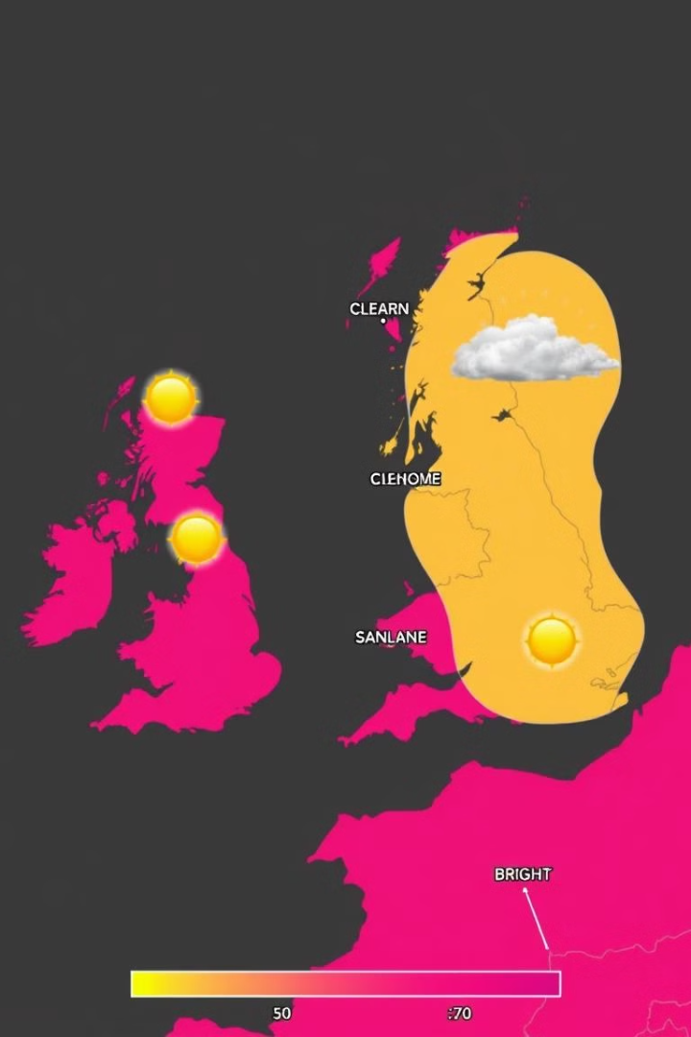
Filtering Data by Weather Condition
Filtering allows you to select specific subsets of your data based on certain conditions. To find all records where the weather was exactly clear, you can use boolean indexing.
This creates a new DataFrame containing only the rows that meet the specified weather condition. Filtering is a powerful way to focus on particular events or patterns in your data.
Example: data[data['Weather Condition'] == 'Clear']

Slide 7
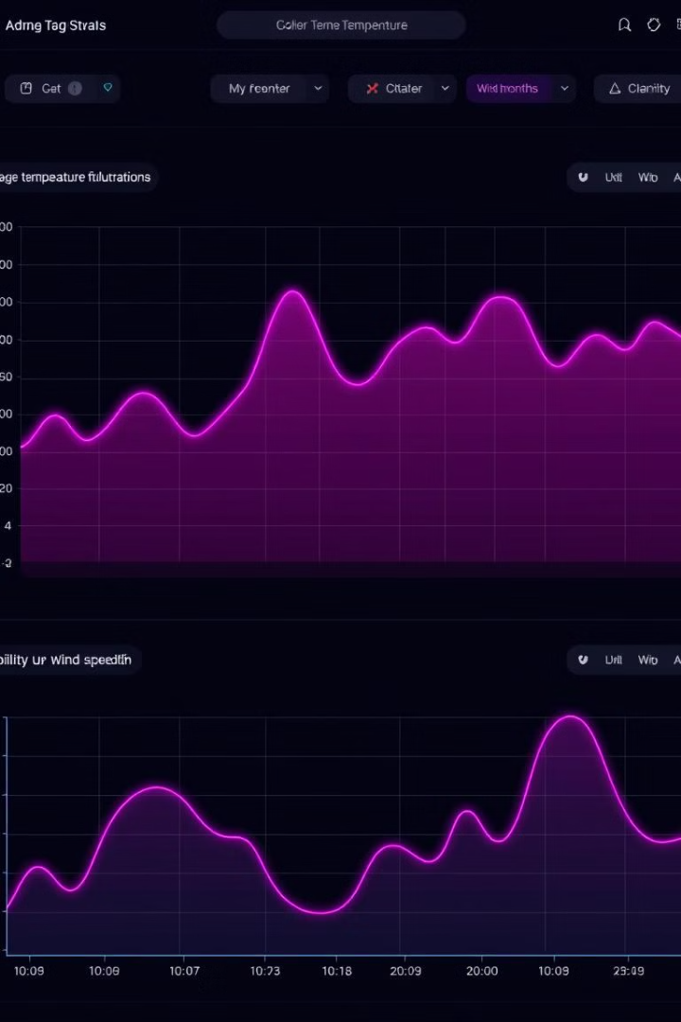
Calculating Descriptive Statistics
Descriptive statistics provide insights into the central tendency and variability of your data. The mean temperature, wind speed, and visibility can be calculated using the mean() function.
These statistics summarize the average conditions in the dataset, providing a quick overview of typical weather patterns.
Example: data[['Temperature', 'Wind Speed', 'Visibility']].mean()

Slide 8

Analyzing Variance of Pressure
Variance measures the spread or dispersion of data points around the mean. To find the variance of the 'Pressure' column, use the var() function. This provides insight into how much the pressure varies within the dataset, indicating the stability or fluctuation of atmospheric conditions.
Example: data['Pressure'].var()

Slide 9

Combining Conditions for Data Extraction
Extracting data based on multiple conditions can reveal more complex patterns. You can find days where the wind speed was more than 30 km/h and the temperature was greater than 0°C by combining boolean conditions.
Example: data[(data['Wind Speed'] > 30) & (data['Temperature'] > 0)]

